Slide 1
Reinforcement Learning
NGSchool 2019
Robert Loftin
Post-Doc Researcher
Microsoft Research, Cambridge, UK
t-roloft@microsoft.com
Slides Courtesy of Katja Hoffmann

Slide 2
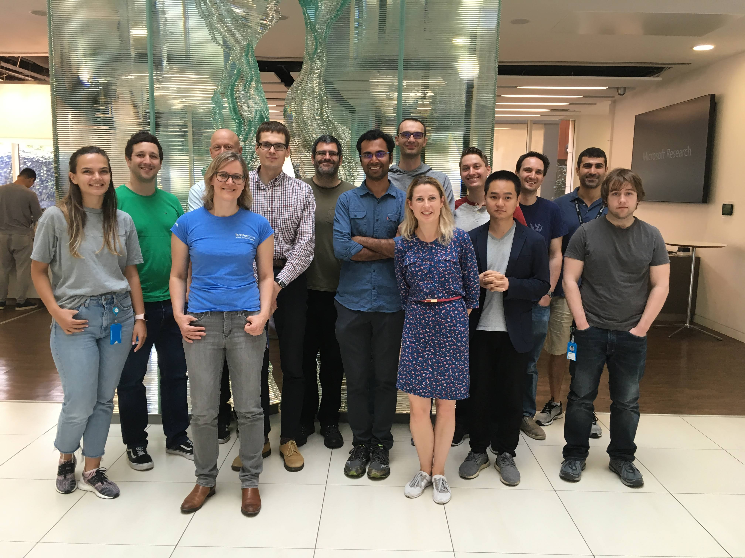

BS Computer Science – 2011
Georgia Tech
PhD Computer Science – 2019
North Carolina State University
Currently a Post-Doc at Microsoft Research in Cambridge, UK
Research interests include:
Human-in-the-loop RL
Multi-agent Reinforcement Learning
Human abstractions in RL
Notes:
My day job: lead research team at MSR – focus on RL in video games – believe this is a great platform to develop AI that learns to collaborate with people – in games and beyond

Slide 3
Reinforcement Learning (RL)
The problem of learning to make decisions in uncertain environments
A class of algorithms which learn to solve decision problems based on their own experiences

Slide 4
Common Features of RL Problems
Sequential Decision Making:
Completing the task requires long-term planning
The agent must handle unexpected situations

Slide 5
Common Features of RL Problems
Acting under uncertainty:
In the outcomes of the agent’s actions
In the agent’s objective itself
RL agents must handle two forms of uncertainty:
Aleatoric: The inherent non-determinism of the problem
Epistemic: The agent’s lack of knowledge about the problem

Slide 6
Common Features of RL Problems
Active Learning:
The agent’s own actions determine what data it observes
Must trade-off between Exploration and Exploitation

Slide 7
RL can model a vast range of problems
Example problems that motivated RL research
Optimal Control
Games
Animal Learning
Notes:
Start with historical perspective: animal learning, games, optimal control -- what do these have in common? All contributed to modern reinforcement learning

Slide 8
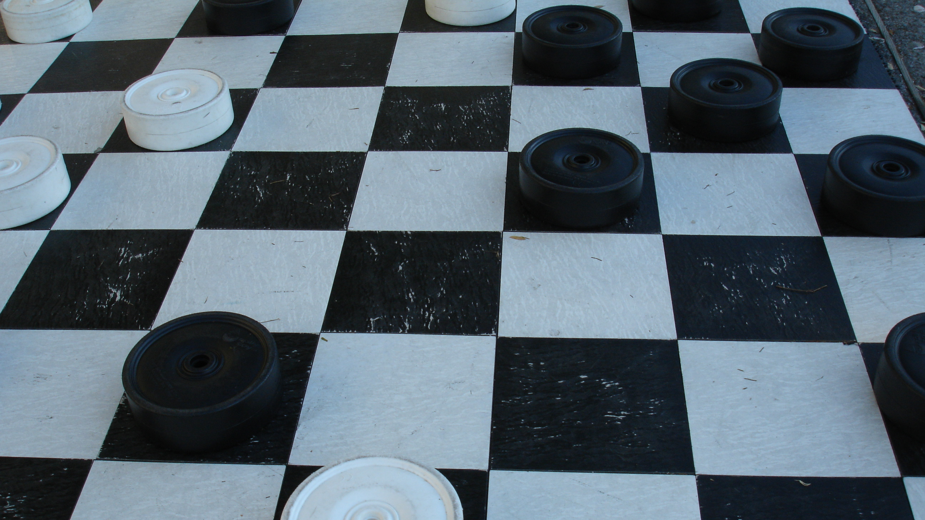
Samuel, A. L. (1959). Some studies in machine learning using the game of checkers. IBM Journal on Research and Development, 3(3), 210–229.
Samuel, A. L. (1967). Some studies in machine learning using the game of checkers. II—Recent progress. IBM Journal on Research and Development, 11(6):601–617
Photo credit: https://www.flickr.com/photos/shawnzlea/261793051/
Notes:
Paper links:
https://pdfs.semanticscholar.org/e9e6/bb5f2a04ae30d8ecc9287f8b702eedd7b772.pdf
https://www.cs.virginia.edu/~evans/greatworks/samuel.pdf

Slide 9
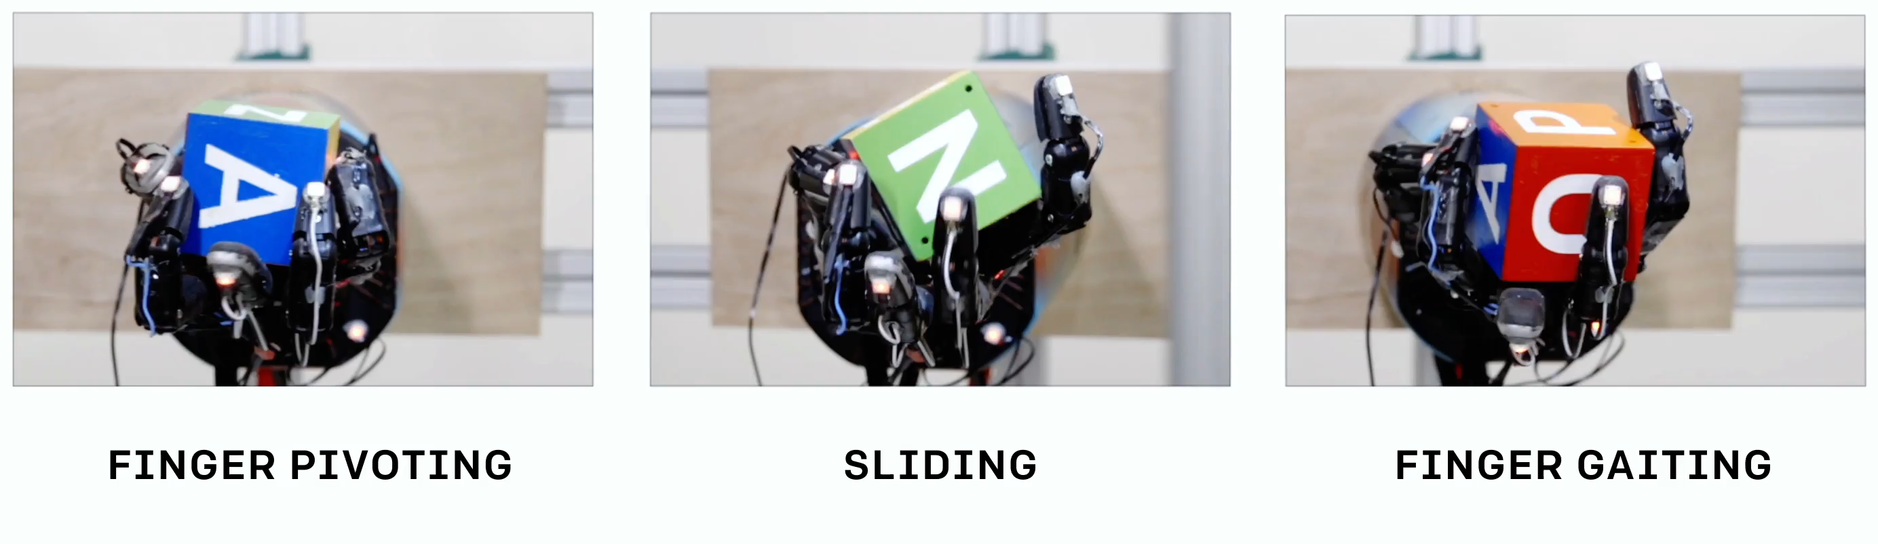
Robotic Control
S. Sidor, J. Pachocki, M. Plappert, J. Tobin, P. Welinder, J. Schneider, A. Petron, M. Andrychowicz, A. Ray, L. Weng, R. Józefowicz, B. Baker – OpenAI – https://openai.com/blog/learning-dexterity/

Slide 10
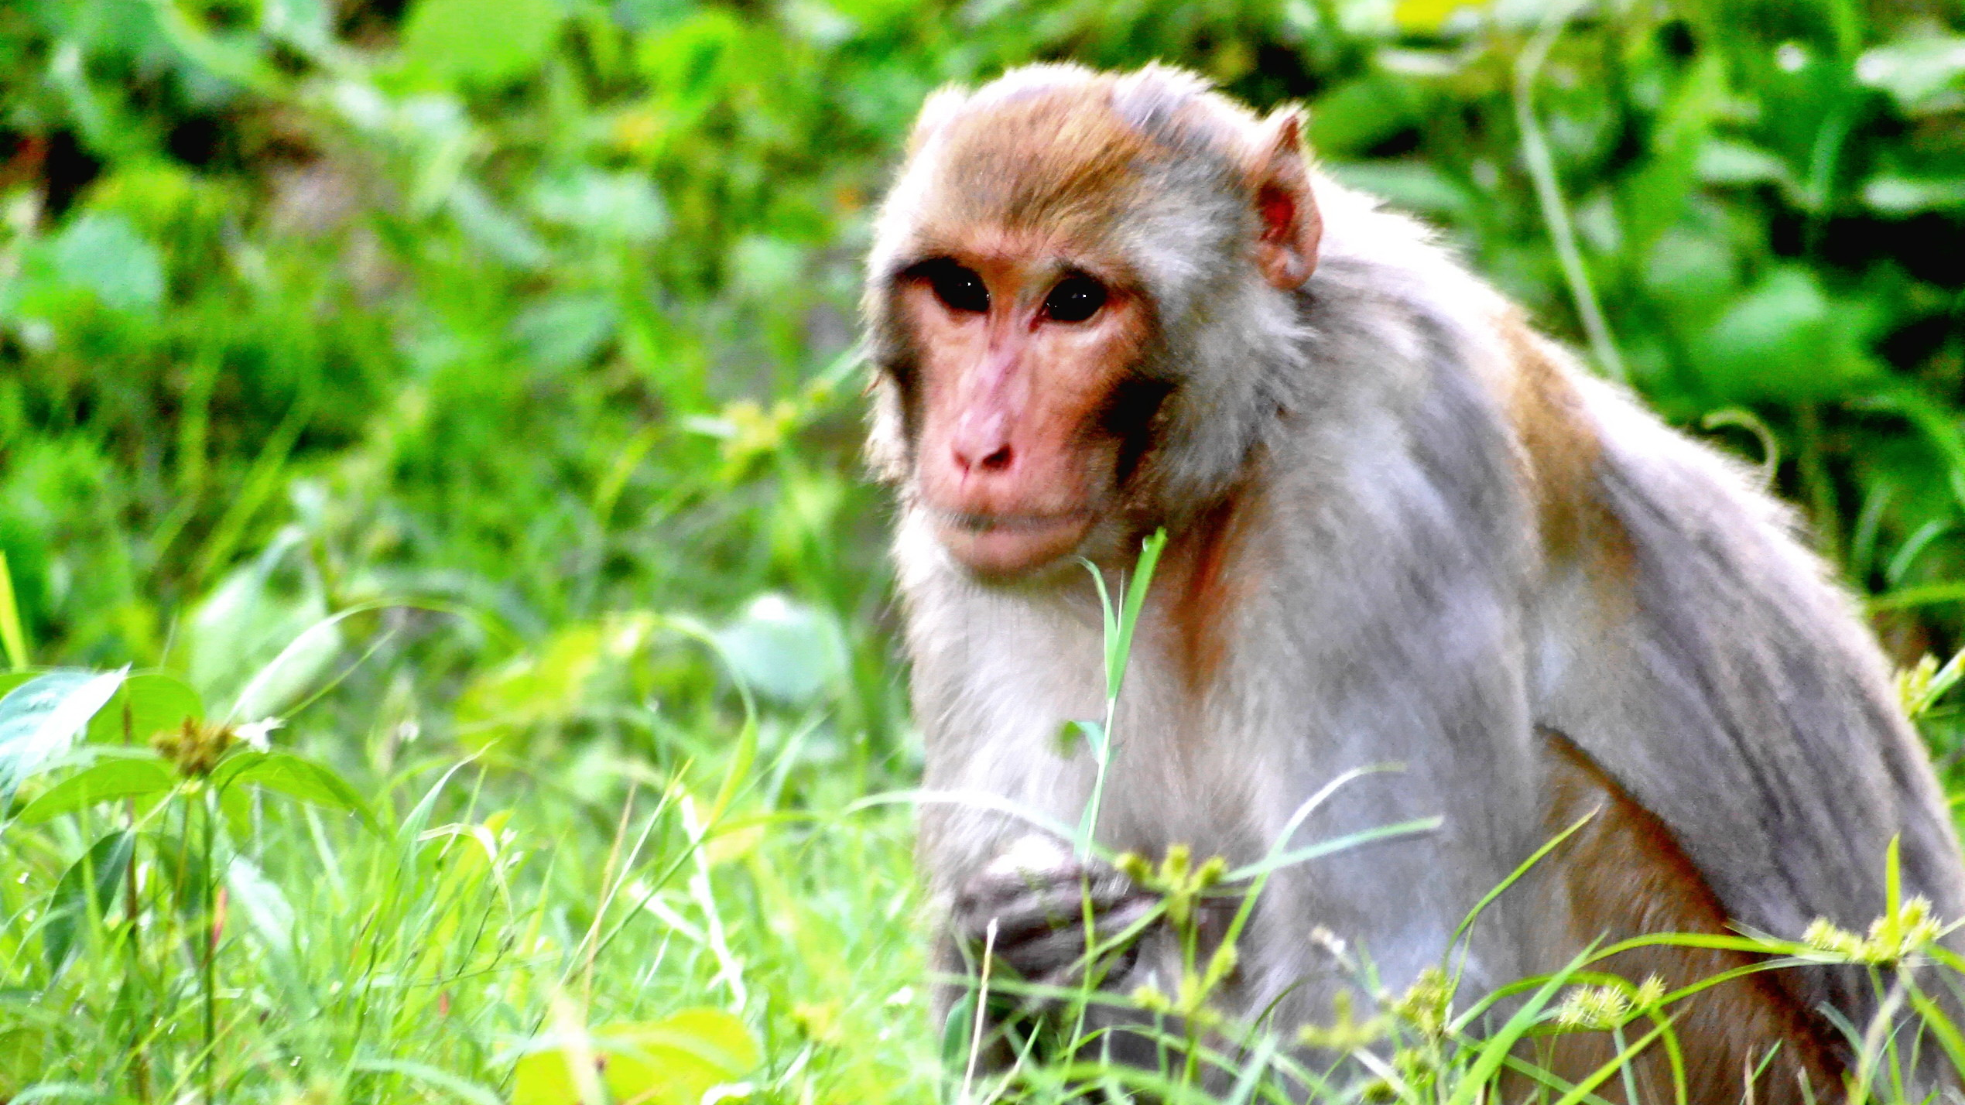
Schultz, Wolfram, Peter Dayan, and P. Read Montague. "A neural substrate of prediction and reward." Science 275.5306 (1997): 1593-1599.
Photo credit: https://www.flickr.com/photos/scorius/750037290
Notes:
http://www.gatsby.ucl.ac.uk/~dayan/papers/sdm97.pdf

Slide 11
Applications of RL in Medicine
Edwards, A. L., Dawson, M. R., Hebert, J. S., Sherstan, C., Sutton, R. S., Chan, K. M., & Pilarski, P. M. (2016). Application of real-time machine learning to myoelectric prosthesis control: A case series in adaptive switching. Prosthetics and orthotics international, 40(5).
Schulte P.J., Tsiatis A.A., Laber E.B., Davidian M. Q- and A-learning Methods for Estimating Optimal Dynamic Treatment Regimes. Stat Sci. 2014;29(4):640–661.
Notes:
Leave 5-10 minutes to conclude

Slide 12
Agenda
Lecture:
Formalizing RL
Exploration vs. Exploitation
Policy Gradient Methods
Q-Learning
Actor-Critic Methods
(Time Permitting):
Partial Observability
Multi-Agent RL
Imitation Learning
Exploration in Deep RL
Tutorial:
Implementing Deep RL Agents
Notes:
5 minutes

Slide 13
Formalizing RL
Notes:
Important because: common language to express wide range of problems – enables reasoning about all RL problems at once, and finding generic solution approaches

Slide 14

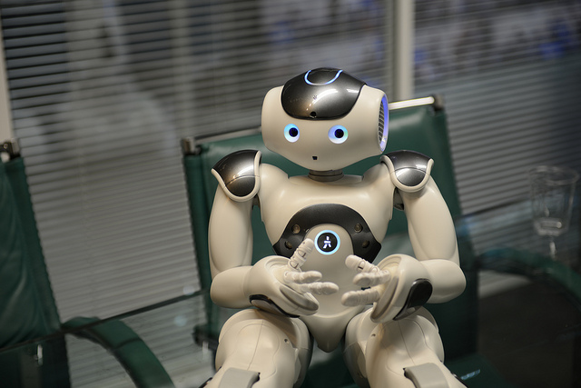
In RL – agent interacts with an environment
agent
environment
Photo credit: https://www.flickr.com/photos/steveonjava/8170183457

Slide 15
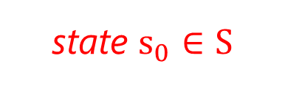
In RL – agent interacts with an environment
agent
environment
state $s_{0}∈S$
Photo credit: https://www.flickr.com/photos/steveonjava/8170183457

Slide 16
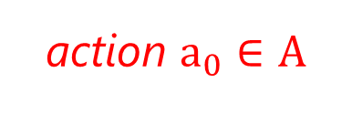
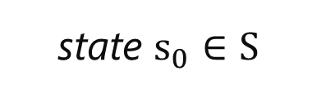
In RL – agent interacts with an environment
action $a_{0}∈A$
agent
environment
state $s_{0}∈S$
Photo credit: https://www.flickr.com/photos/steveonjava/8170183457

Slide 17
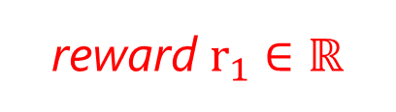
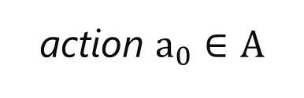
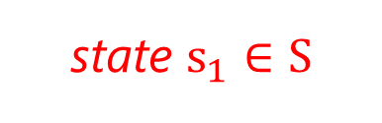
In RL – agent interacts with an environment
action $a_{0}∈A$
agent
reward $r_{1}∈ℝ$
environment
state $s_{1}∈S$
Photo credit: https://www.flickr.com/photos/steveonjava/8170183457

Slide 18
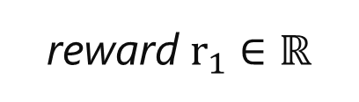
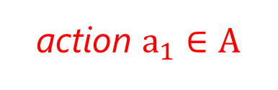
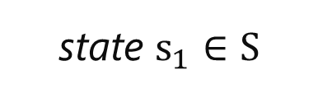
In RL – agent interacts with an environment
action $a_{1}∈A$
agent
reward $r_{1}∈ℝ$
environment
state $s_{1}∈S$
Photo credit: https://www.flickr.com/photos/steveonjava/8170183457

Slide 19
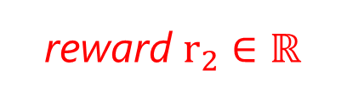
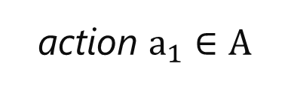
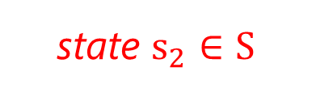
In RL – agent interacts with an environment
action $a_{1}∈A$
agent
reward $r_{2}∈ℝ$
environment
state $s_{2}∈S$
Photo credit: https://www.flickr.com/photos/steveonjava/8170183457

Slide 20
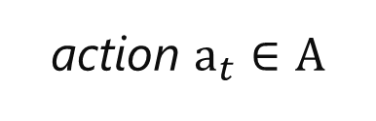
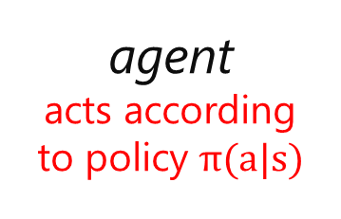
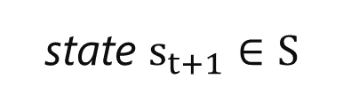
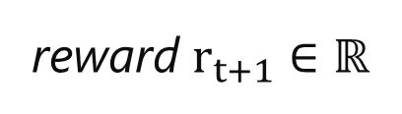
In RL – agent interacts with an environment
action $a_{t}∈A$
agent acts according to policy $π(a|s)$
reward $r_{t+1}∈ℝ$
environment
state $s_{t+1}∈S$
Photo credit: https://www.flickr.com/photos/steveonjava/8170183457
Notes:
Note: transition dynamics typically assumed unknown – policy has to be learned from experience

Slide 21
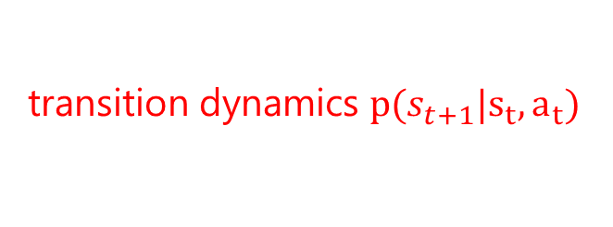
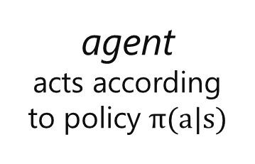
In RL – agent interacts with an environment
action $a_{t}∈A$
agent acts according to policy $π(a|s)$
reward $r_{t+1}∈ℝ$
environment
transition dynamics $p(s_{t+1}|s_{t},a_{t})$
state $s_{t+1}∈S$
Photo credit: https://www.flickr.com/photos/steveonjava/8170183457
Notes:
Note: transition dynamics typically assumed unknown – policy has to be learned from experience

Slide 22
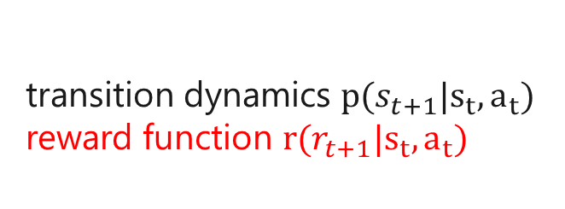
In RL – agent interacts with an environment
action $a_{t}∈A$
agent acts according to policy $π(a|s)$
reward $r_{t+1}∈ℝ$
environment
transition dynamics $p(s_{t+1}|s_{t},a_{t})$ reward function $r(r_{t+1}|s_{t},a_{t})$
state $s_{t+1}∈S$
Photo credit: https://www.flickr.com/photos/steveonjava/8170183457
Notes:
Note: transition dynamics typically assumed unknown – policy has to be learned from experience

Slide 23
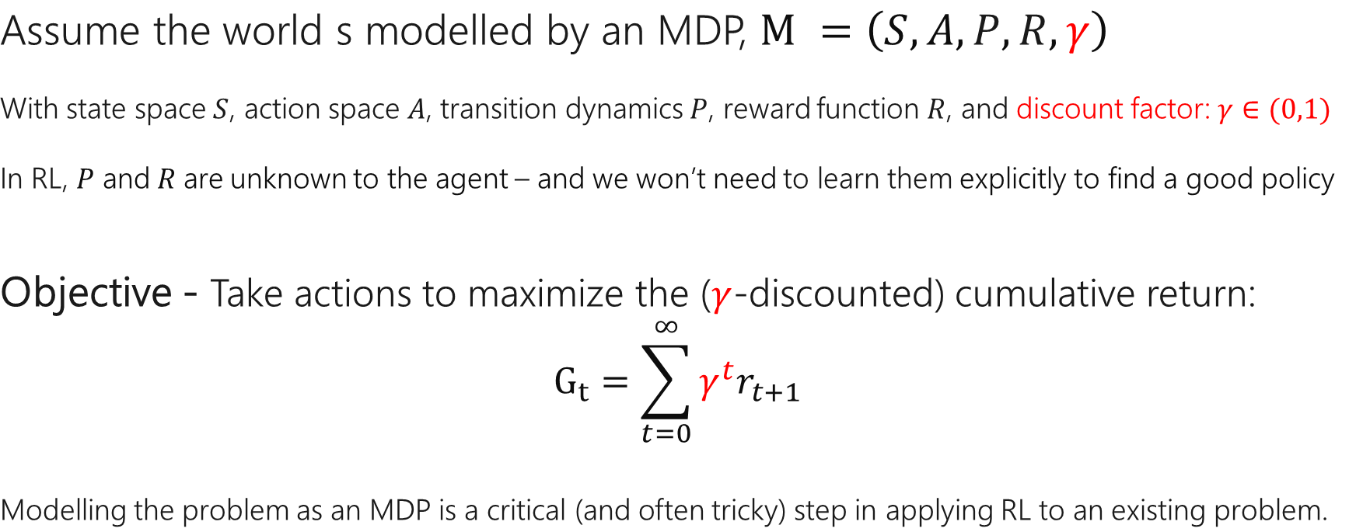
Markov Decision Process (MDP)
Assume the world s modelled by an MDP, $M =\left(S,A, P,R,γ\right)$
With state space $S$, action space $A$, transition dynamics $P$, reward function $R$, and discount factor: $γ∈(0,1)$
In RL, $P$ and$R$ are unknown to the agent – and we won’t need to learn them explicitly to find a good policy
Objective - Take actions to maximize the ($γ$-discounted) cumulative return:
$$G_{t}=\sum_{t=0}^{∞}{γ^{t}r_{t+1}}$$
Modelling the problem as an MDP is a critical (and often tricky) step in applying RL to an existing problem.
Notes:
Given the MDP definition, we can write down optimality criterion

Slide 24
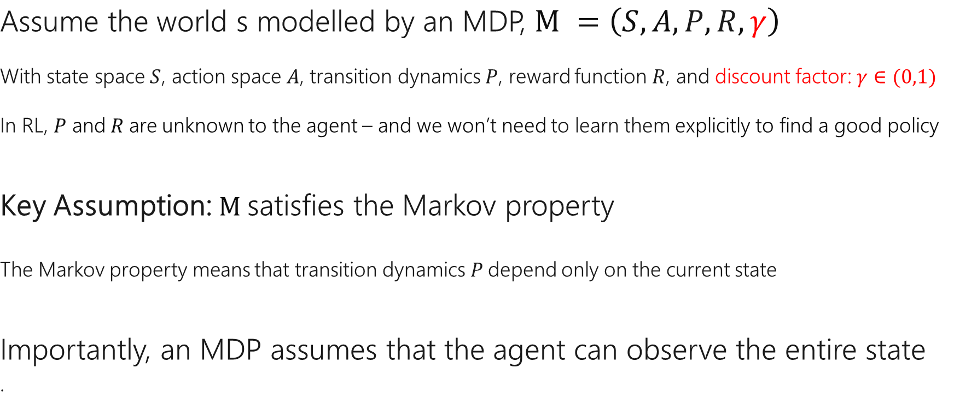
Markov Decision Process (MDP)
Assume the world s modelled by an MDP, $M =\left(S,A, P,R,γ\right)$
With state space $S$, action space $A$, transition dynamics $P$, reward function $R$, and discount factor: $γ∈(0,1)$
In RL, $P$ and$R$ are unknown to the agent – and we won’t need to learn them explicitly to find a good policy
Key Assumption: $M$satisfies the Markov property
The Markov property means that transition dynamics $P$depend only on the current state
Importantly, an MDP assumes that the agent can observe the entire state
.
Notes:
Given the MDP definition, we can write down optimality criterion

Slide 25
State space
The choice of state representation can have a huge impact on the performance of RL.
Considerations:
Is the Markov property satisfied?
Does the state contain all the information the agent needs to solve the task?
How difficult will it be to represent the optimal behaviour as a function of this space?
Notes:
Note: low vs high may not be Markov
Optimal solution – is coarse discretization appropriate or lead to solutions far from optimum?
Data efficiency – more fine-grained / larger state space requires more data – is data cheap? Or better leverage more expert data?

Slide 26
Action space
Another Important modelling choice, common variants:
Discrete, e.g., on/off, which button to press (Atari)
Continuous, e.g., how much force to apply, how quickly to accelerate
Active research area: large, complex action spaces (e.g., combinatorial, mixed discrete/continuous, natural language)
In practice - we can often get food performance with relatively simple action spaces.

Slide 27
Rewards
How do we define the goals for an RL agent?
In some settings – a natural reward signal may be available (e.g., game score in Atari)
More typically – We will need to define a reward function which will corresponds to our desired behavior
For a fun video about bad reward functions: https://blog.openai.com/faulty-reward-functions/

Slide 28
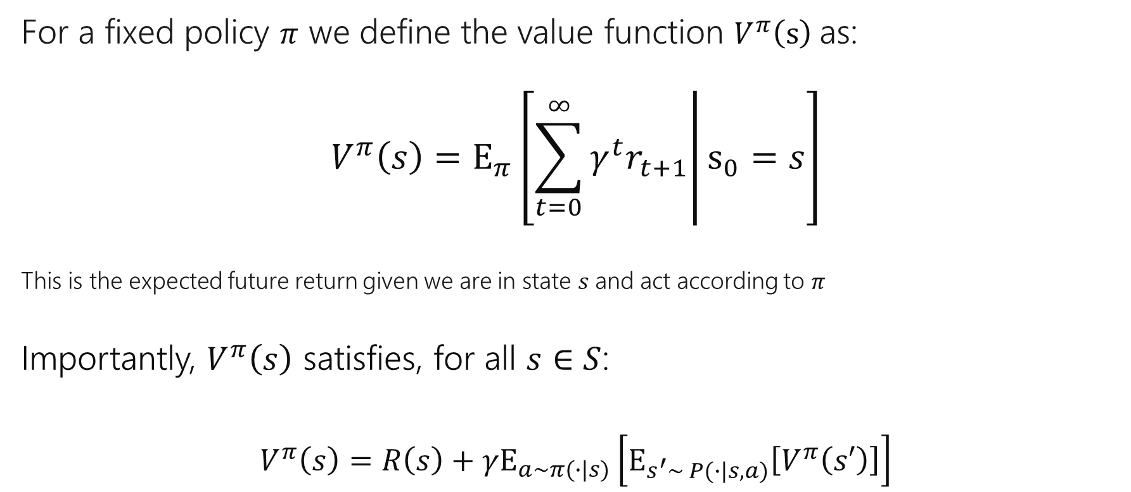
Solving MDPs – Value Functions
For a fixed policy $π$ we define the value function $V^{π}\left(s\right)$as:
$$V^{π}\left(s\right)=E_{π}\left[\left.\sum_{t=0}^{∞}{γ^{t}r_{t+1}}\right|s_{0}=s\right]$$
This is the expected future return given we are in state $s$and act according to $π$
Importantly, $V^{π}\left(s\right)$ satisfies, for all $s∈S$:
$$V^{π}\left(s\right)=R\left(s\right)+γE_{a\sim π(∙|s)}\left[E_{s^{′}\sim P(∙|s,a)}\left[V^{π}\left(s′\right)\right]\right]$$
Notes:
Given the MDP definition, we can write down optimality criterion

Slide 29
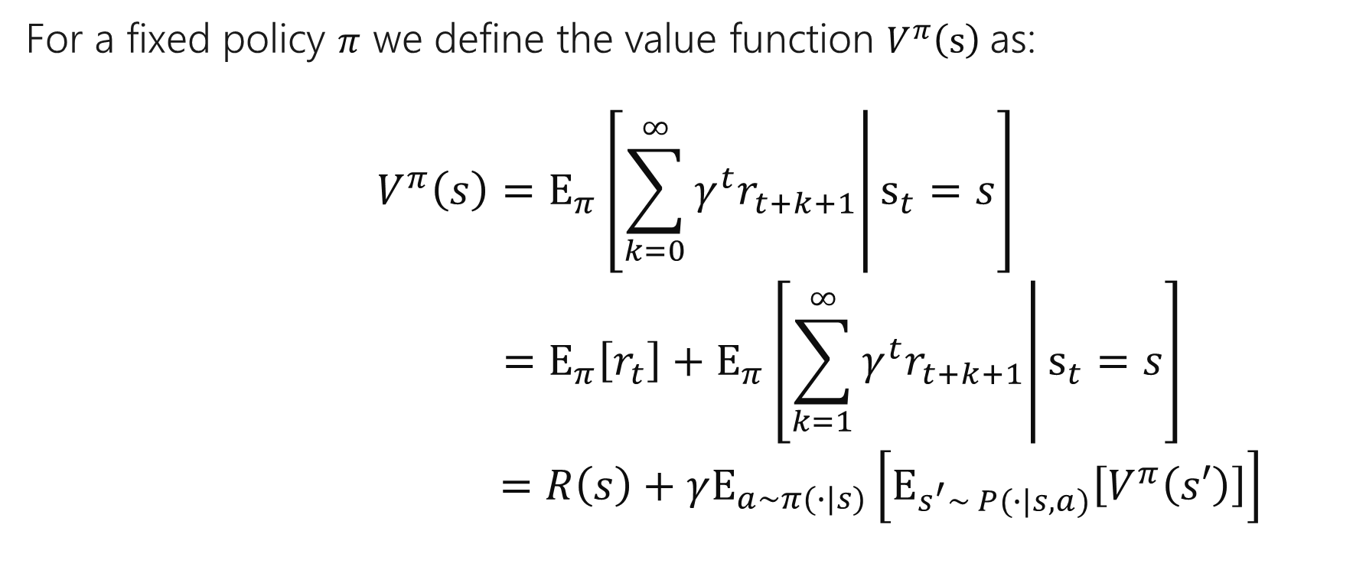
Solving MDPs – Value Functions
For a fixed policy $π$ we define the value function $V^{π}\left(s\right)$as:
$$V^{π}\left(s\right)=E_{π}\left[\left.\sum_{k=0}^{∞}{γ^{t}r_{t+k+1}}\right|s_{t}=s\right]$$
$$=E_{π}\left[r_{t}\right]+E_{π}\left[\left.\sum_{k=1}^{∞}{γ^{t}r_{t+k+1}}\right|s_{t}=s\right]$$
$$=R\left(s\right)+γE_{a\sim π(∙|s)}\left[E_{s^{′}\sim P(∙|s,a)}\left[V^{π}\left(s′\right)\right]\right]$$
Notes:
Given the MDP definition, we can write down optimality criterion

Slide 30
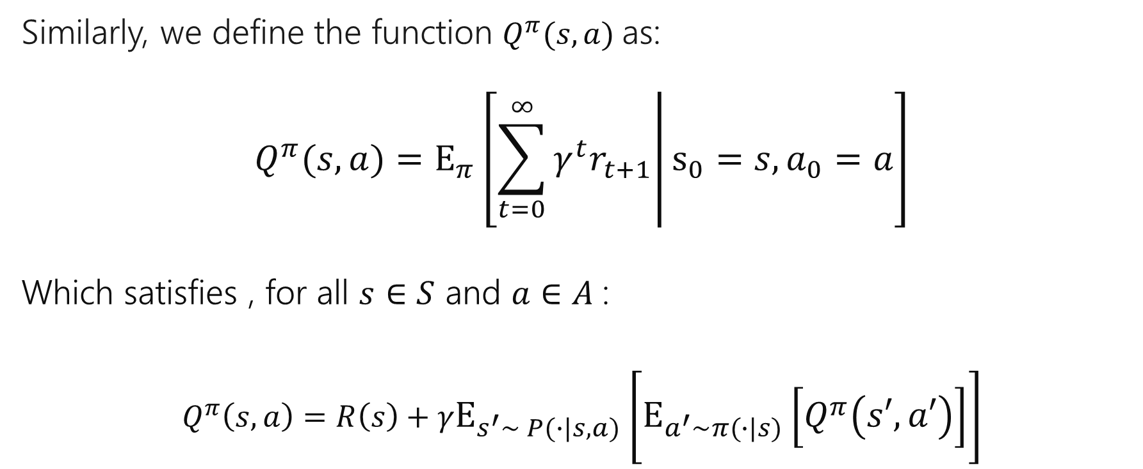
Solving MDPs – Q Functions
Similarly, we define the function $Q^{π}(s,a)$as:
$$Q^{π}(s,a)=E_{π}\left[\left.\sum_{t=0}^{∞}{γ^{t}r_{t+1}}\right|s_{0}=s, a_{0}=a\right]$$
Which satisfies , for all $s∈S$ and $a∈A$:
$$Q^{π}\left(s,a\right)=R\left(s\right)+γE_{s^{′}\sim P(∙|s,a)}\left[E_{a^{′}\sim π(∙|s)}\left[Q^{π}\left(s′,a′\right)\right]\right]$$
Notes:
Given the MDP definition, we can write down optimality criterion

Slide 31
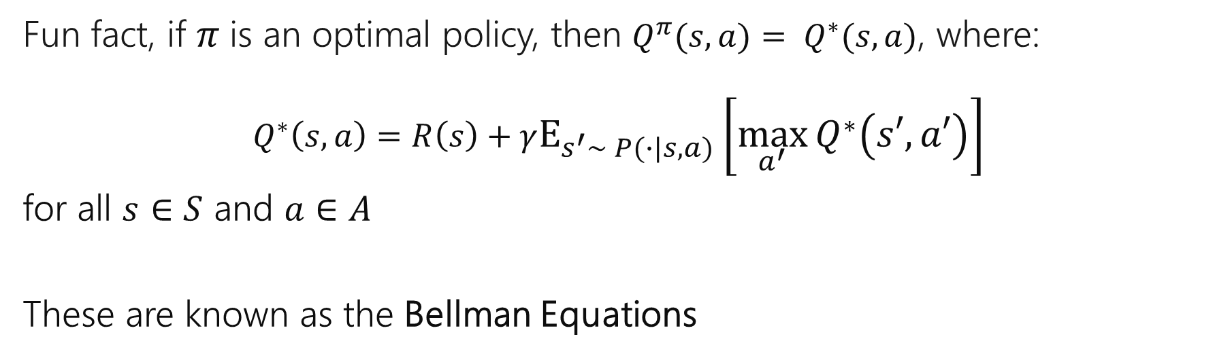
Solving MDPs – Bellman Equations
Fun fact, if $π$is an optimal policy, then $Q^{π}(s,a)= Q^{∗}(s,a)$, where:
$$Q^{∗}\left(s,a\right)=R\left(s\right)+γE_{s^{′}\sim P(∙|s,a)}\left[\max_{a^{′}}{Q^{∗}\left(s′,a′\right)}\right]$$
for all $s∈S$ and $a∈A$
These are known as the Bellman Equations
Notes:
Given the MDP definition, we can write down optimality criterion

Slide 32
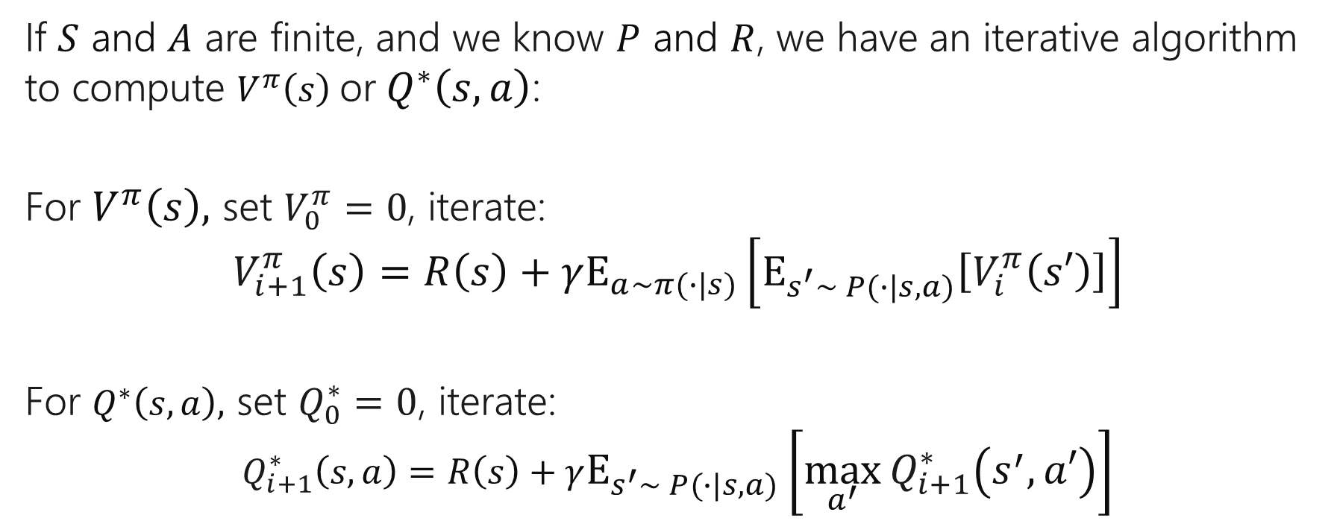
Solving MDPs – Value Iteration
If $S$ and $A$ are finite, and we know $P$ and $R$, we have an iterative algorithm to compute $V^{π}\left(s\right)$or$Q^{∗}\left(s,a\right)$:
For $V^{π}\left(s\right),$ set $V_{0}^{π}=0$, iterate:
$$V_{i+1}^{π}\left(s\right)=R\left(s\right)+γE_{a\sim π(∙|s)}\left[E_{s^{′}\sim P(∙|s,a)}\left[V_{i}^{π}\left(s′\right)\right]\right]$$
For $Q^{∗}\left(s, a\right),$ set $Q_{0}^{∗}=0$, iterate:
$$Q_{i+1}^{∗}\left(s,a\right)=R\left(s\right)+γE_{s^{′}\sim P(∙|s,a)}\left[\max_{a^{′}}{Q_{i+1}^{∗}\left(s^{′},a′\right)}\right]$$
Notes:
Given the MDP definition, we can write down optimality criterion

Slide 33
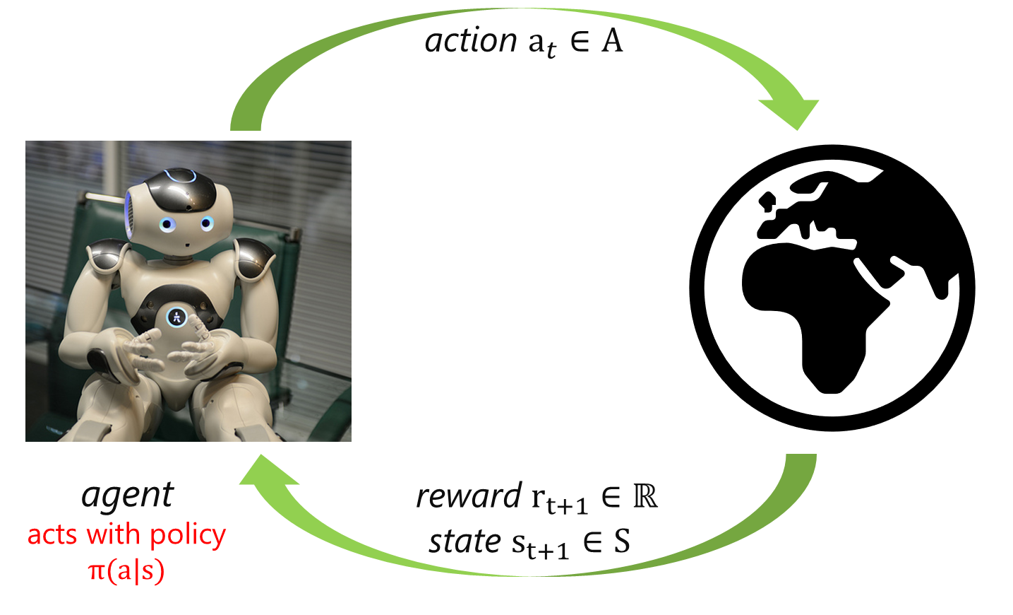
Key Challenge: Balancing Exploration vs. Exploitation

Slide 34
Exploration vs Exploitation - Example
In a clinical trial, for each new patient we must balance between giving the most effective treatment and evaluating the alternatives.
How do we decide which treatment to give new each patient?
Option 1: Randomly assign each patient to a treatment
Option 2: Pick the best treatment once we reach a fixed confidence threshold
Option 3: Gradually increase the number of patients assigned to the current most effective treatments
Notes:
Note: low vs high may not be Markov
Optimal solution – is coarse discretization appropriate or lead to solutions far from optimum?
Data efficiency – more fine-grained / larger state space requires more data – is data cheap? Or better leverage more expert data?

Slide 35
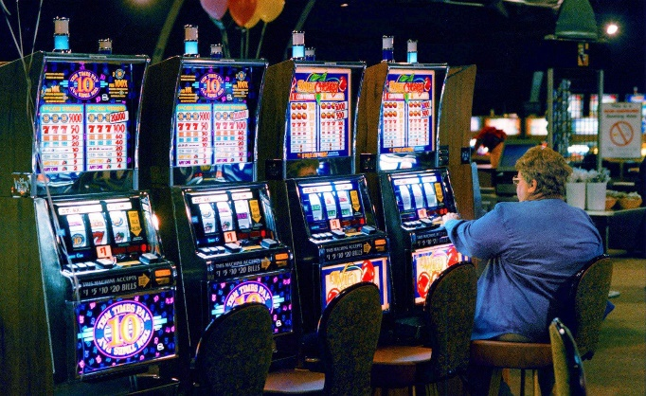
Exploration vs Exploitation – Multi-Armed Bandits
Imagine you have four slot machines, with unknown payoff distributions – how to decide which to choose?
We model this problem as an MDP with no states
Notes:
Context: often studied in multi-armed bandit setting

Slide 36
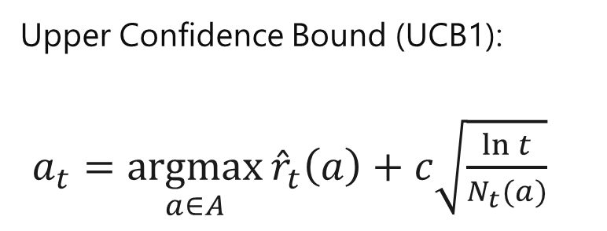
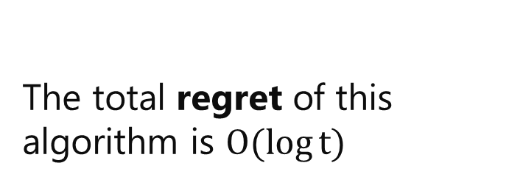
Exploration vs Exploitation – UCB1 Algorithm
Upper Confidence Bound (UCB1):
$a_{t}=\underset{a∈A}{argmax}{{\hat{r}}_{t}\left(a\right)}+c\sqrt{\frac{\ln{t}}{N_{t}(a)}}$
[Auer et al. ’02]
The total regret of this algorithm is $O(\log{t})$

Slide 37
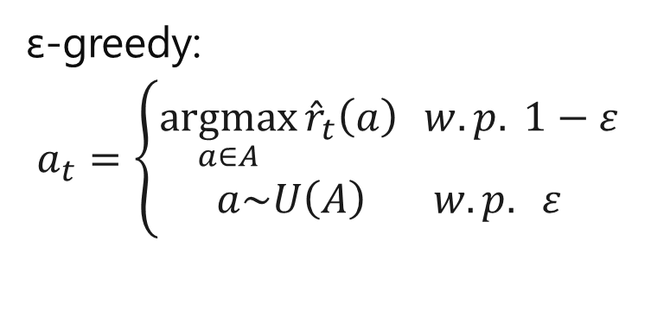
Exploration vs Exploitation – ε-greedy
ε-greedy:
$$a_{t}=\left\{\begin{matrix}\underset{a∈A}{argmax}{{\hat{r}}_{t}\left(a\right) } w. p. 1−ε \\ a\sim U\left(A\right) w. p. ε\end{matrix}\right.$$
Simple to implement
Theoretical guarantees
Often competitive in practice

Slide 38
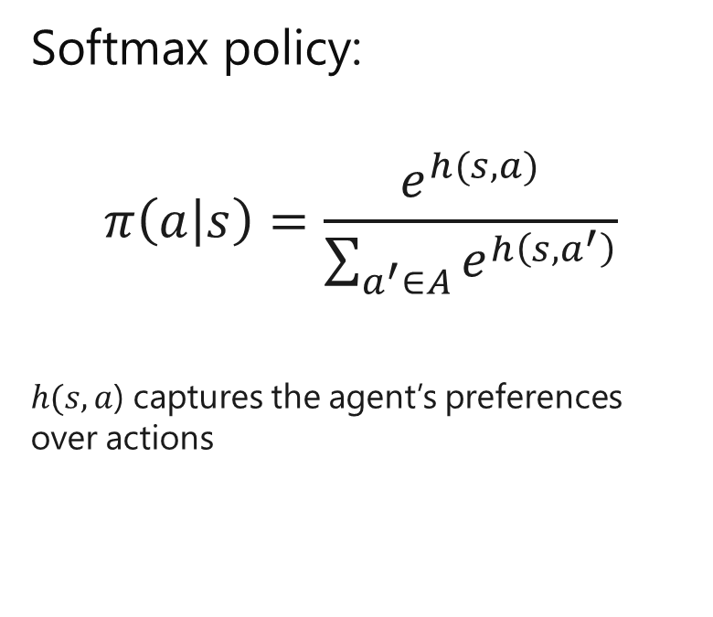
Exploration vs Exploitation – Softmax action selection
Softmax policy:
$$π\left(a | s\right)=\frac{e^{h(s,a)}}{\sum_{a^{′}∈A}{e^{h\left(s,a^{′}\right)}}}$$
$h(s,a$) captures the agent’s preferences over actions

Slide 39
RL Approach 1: Policy Gradient Methods

Slide 40
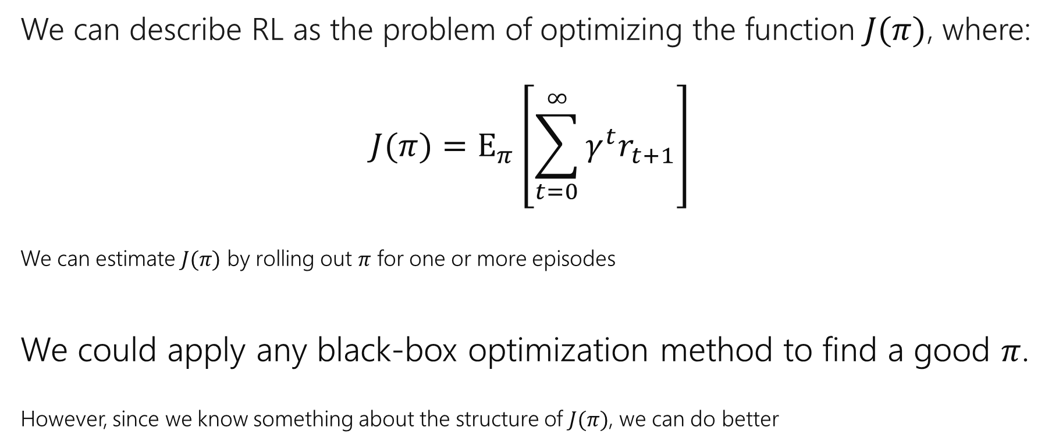
Policy Gradient – RL as Optimization
We can describe RL as the problem of optimizing the function $J(π)$, where:
$$J(π)=E_{π}\left[\sum_{t=0}^{∞}{γ^{t}r_{t+1}}\right]$$
We can estimate $J(π)$ by rolling out $π$ for one or more episodes
We could apply any black-box optimization method to find a good $π$.
However, since we know something about the structure of $J(π)$, we can do better
Notes:
Given the MDP definition, we can write down optimality criterion

Slide 41

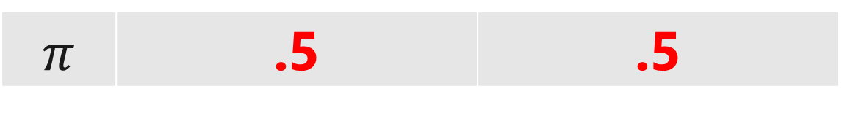
Policy Gradient - Intuition
Decrease the probability of actions when they lead to negative reward
$$π$$ | .5 | .5
Photo credit: https://www.flickr.com/photos/knothing/11264853546/

Slide 42
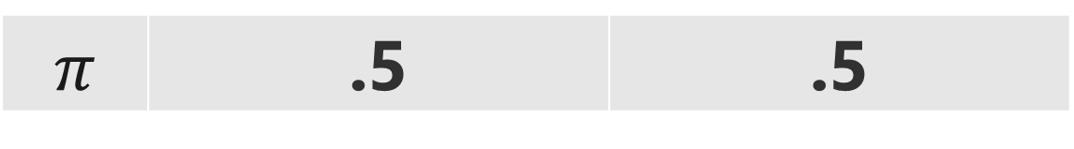
Policy Gradient - Intuition
Decrease the probability of actions when they lead to negative reward
$$π$$ | .5 | .5
Photo credit: https://www.flickr.com/photos/knothing/11264853546/

Slide 43
Policy Gradient - Intuition
Decrease the probability of actions when they lead to negative reward
Loose ☹
$$π$$ | .5 | .5
Photo credit: https://www.flickr.com/photos/knothing/11264853546/

Slide 44
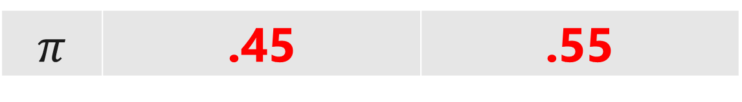
Policy Gradient - Intuition
Decrease the probability of actions when they lead to negative reward
$$π$$ | .45 | .55
Photo credit: https://www.flickr.com/photos/knothing/11264853546/

Slide 45
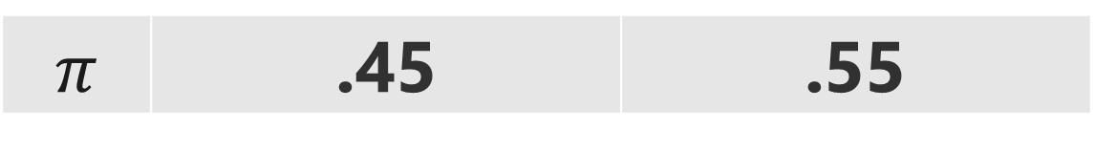
Policy Gradient - Intuition
Increase the probability of actions when they lead to positive reward
$$π$$ | .45 | .55
Photo credit: https://www.flickr.com/photos/knothing/11264853546/

Slide 46
Policy Gradient - Intuition
Increase the probability of actions when they lead to positive reward
Win! ☺
$$π$$ | .45 | .55
Photo credit: https://www.flickr.com/photos/knothing/11264853546/

Slide 47
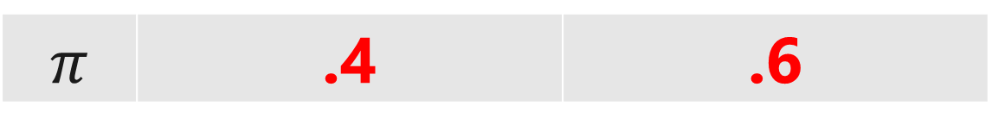
Policy Gradient - Intuition
Increase the probability of actions when they lead to positive reward
$$π$$ | .4 | .6
Photo credit: https://www.flickr.com/photos/knothing/11264853546/

Slide 48
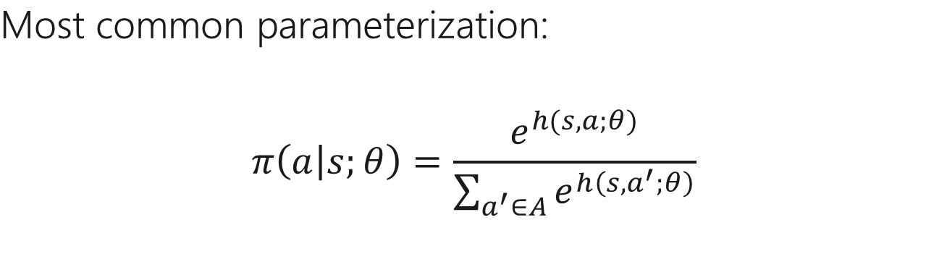
Parametric Policies
Most common parameterization:
$$π\left(a | s;θ\right)=\frac{e^{h(s,a;θ)}}{\sum_{a^{′}∈A}{e^{h\left(s,a^{′};θ\right)}}}$$

Slide 49

Parametric Policies
Most common parameterization:
$$π\left(a | s;θ\right)=\frac{e^{h(s,a;θ)}}{\sum_{a^{′}∈A}{e^{h\left(s,a^{′};θ\right)}}}$$
probability distribution over discrete actions, given the current state

Slide 50
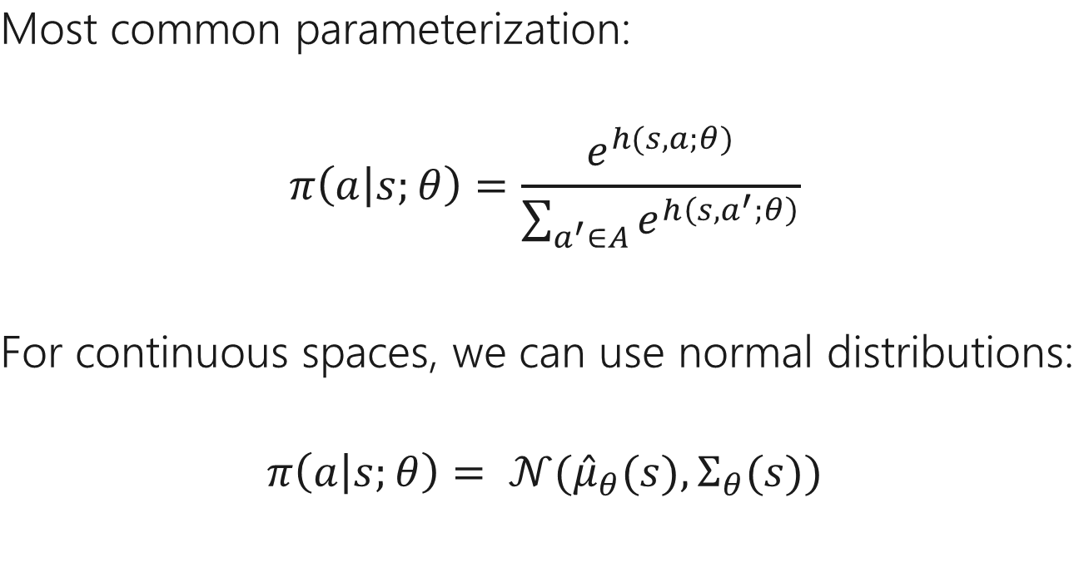
Parametric Policies
Most common parameterization:
$$π\left(a | s;θ\right)=\frac{e^{h(s,a;θ)}}{\sum_{a^{′}∈A}{e^{h\left(s,a^{′};θ\right)}}}$$
For continuous spaces, we can use normal distributions:
$$π\left(a | s;θ\right)= 𝒩({\hat{μ}}_{θ}(s),Σ_{θ}(s))$$

Slide 51

Parametric Policies
Most common parameterization:
$$π\left(a | s;θ\right)=\frac{e^{h(s,a;θ)}}{\sum_{a^{′}∈A}{e^{h\left(s,a^{′};θ\right)}}}$$
The policy has learnable parameters

Slide 52

Parametric Policies
The policy parameters encode action preferences – more preferred actions are more likely
Most common parameterization:
$$π\left(a | s;θ\right)=\frac{e^{h(s,a;θ)}}{\sum_{a^{′}∈A}{e^{h\left(s,a^{′};θ\right)}}}$$

Slide 53

Parametric Policies
Most common parameterization:
$$π\left(a | s;θ\right)=\frac{e^{h(s,a;θ)}}{\sum_{a^{′}∈A}{e^{h\left(s,a^{′};θ\right)}}}$$
The denominator ensures normalized probabilities
Notes:
Note: connection to supervised learning – cross entropy loss
Powerful parametric form: can leverage gradient descent

Slide 54
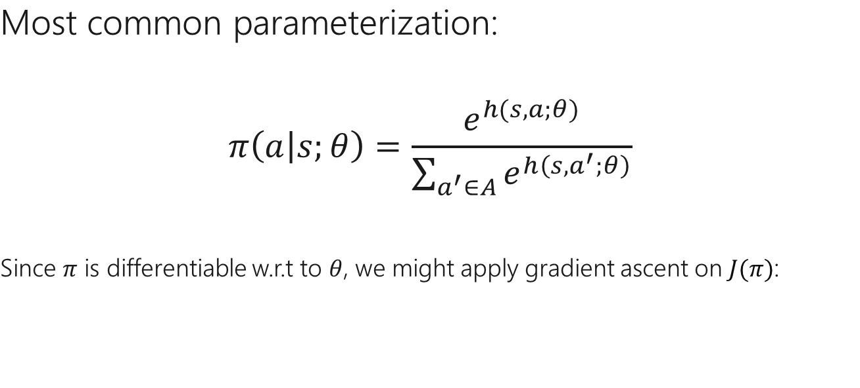
Parametric Policies
Most common parameterization:
$$π\left(a | s;θ\right)=\frac{e^{h(s,a;θ)}}{\sum_{a^{′}∈A}{e^{h\left(s,a^{′};θ\right)}}}$$
Since $π$ is differentiable w.r.t to $θ$, we might apply gradient ascent on $J(π)$:

Slide 55
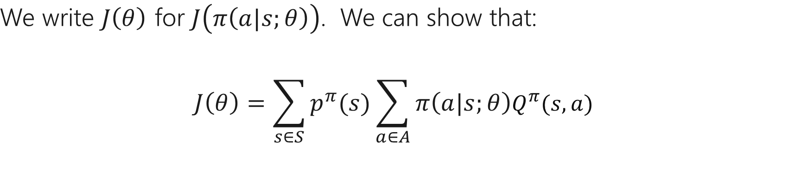
Policy Gradient
We write $J\left(θ\right)$ for $J\left(π\left(a|s;θ\right)\right)$. We can show that:
$$J\left(θ\right)=\sum_{s∈S}{p^{π}(s)\sum_{a∈A}{π\left(a|s;θ\right)Q^{π}(s,a)}}$$
Notes:
How to change policy to improve return – stochastic gradient ascent!

Slide 56
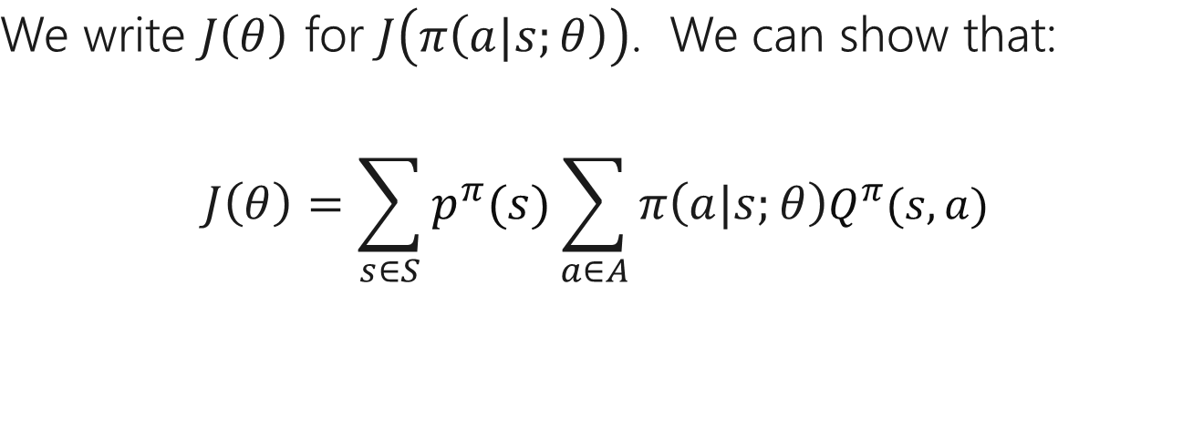
Policy Gradient
We write $J\left(θ\right)$ for $J\left(π\left(a|s;θ\right)\right)$. We can show that:
$$J\left(θ\right)=\sum_{s∈S}{p^{π}(s)\sum_{a∈A}{π\left(a|s;θ\right)Q^{π}(s,a)}}$$

Slide 57
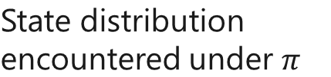
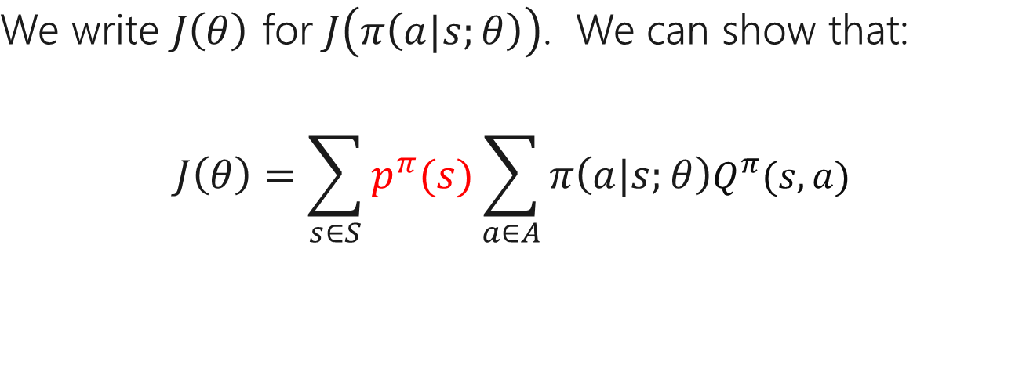
Policy Gradient
We write $J\left(θ\right)$ for $J\left(π\left(a|s;θ\right)\right)$. We can show that:
$$J\left(θ\right)=\sum_{s∈S}{p^{π}(s)\sum_{a∈A}{π\left(a|s;θ\right)Q^{π}(s,a)}}$$
State distribution encountered under $π$

Slide 58

Policy Gradient
We write $J\left(θ\right)$ for $J\left(π\left(a|s;θ\right)\right)$. We can show that:
$$J\left(θ\right)=\sum_{s∈S}{p^{π}(s)\sum_{a∈A}{π\left(a|s;θ\right)Q^{π}(s,a)}}$$
State distribution encountered under $π$
The parameterized policy

Slide 59


Policy Gradient
We write $J\left(θ\right)$ for $J\left(π\left(a|s;θ\right)\right)$. We can show that:
$$J\left(θ\right)=\sum_{s∈S}{p^{π}(s)\sum_{a∈A}{π\left(a|s;θ\right)Q^{π}(s,a)}}$$
State distribution encountered under $π$
The parameterized policy
Expected return when starting from state $s$ and taking action $a$

Slide 60

Policy Gradient
We write $J\left(θ\right)$ for $J\left(π\left(a|s;θ\right)\right)$. We can show that:
$$J\left(θ\right)=\sum_{s∈S}{p^{π}(s)\sum_{a∈A}{π\left(a|s;θ\right)Q^{π}(s,a)}}$$
Challenge: How do we differentiate $p^{π}(s)$ w.r.t $θ$?

Slide 61

The Policy Gradient Theorem
Key insight: gradient of $J(θ)$ does not require the derivatives of${ p}^{π}(s)$
$$∇_{θ}J\left(θ\right)∝\sum_{s∈S}{p^{π}(s)\sum_{a∈A}{∇_{θ}π\left(a|s;θ\right)}}Q^{π}(s,a)$$
$$=𝔼_{π}\left[∇_{θ}log{π\left(a|s;θ\right)}Q^{π}(s,a)\right]$$
Sutton, R. S., McAllester, D. A., Singh, S. P., & Mansour, Y. (2000). Policy gradient methods for reinforcement learning with function approximation. NIPS 2000.
See Sutton & Barto 2018, chapter 13
Notes:
Policy gradient theorem: likelihood ratio estimate extended to multi-step MDP, long-term reward R; this holds for any differentiable function

Slide 62



The Policy Gradient Theorem
Terms can be estimated from roll-out data!
$$E_{π}\left[∇_{θ}\log{π\left(a|s;θ\right)}\vec{R}\right]$$
Rollout the current policy $π$
Implement forward pass in your favourite deep learning framework + auto-diff to compute gradients
Remaining Episode return under $π$
$E_{π}\left[\vec{R} | s, a\right]$ = $Q^{π}(s,a)$
Sutton, R. S., McAllester, D. A., Singh, S. P., & Mansour, Y. (2000). Policy gradient methods for reinforcement learning with function approximation. NIPS 2000.
See Sutton & Barto 2018, chapter 13
Notes:
Key quantities can be estimated from data!

Slide 63

Policy Gradient Algorithm: REINFORCE
Williams, R. J. (1992). Simple statistical gradient-following algorithms for connectionist reinforcement learning. Machine learning, 8(3-4), 229-256. Algorithm from: Sutton & Barto 2018, chapter 13, page 328

Slide 64

Policy Gradient - Limitations
Estimating$∇_{θ}J\left(θ\right)$ using random roll-outs means that REINFORCE is doing stochastic gradient ascent on $J\left(θ\right)$.
Challenge 1: the roll-out gradient $∇_{θ}J\left(θ\right)$ may have high variance
Gradient ascent may be slow to converge to a good solution
Challenge 2: We need at least one roll-out for each update of $θ$
Roll-out data is thrown away after each update – highly sample inefficient
In the next two sections look at ways to overcome these issues

Slide 65
RL Approaches 2: Temporal Differences and Q-Learning
Notes:
Pause – Questions?

Slide 66

Reinforcement Learning in Malmo
The agent has to learn to navigate to the blue goal block
Adapted from Sutton & Barto 2018, chapter 6
Try this at home, see https://github.com/Microsoft/malmo - tutorial 6

Slide 67
Challenge - Sample Efficiency
Basic policy gradient methods / REINFORCE don’t take maximum advantage of the roll-outs they generate:
Many roll-outs needed to estimate the gradient
Roll-outs are only useful for the current policy
Can we do better?

Slide 68

Temporal Difference (TD) Error
Recall that, for the optimal Q-funtion:
$$Q^{∗}\left(s,a\right)=R\left(s\right)+γE_{s^{′}\sim P(∙|s,a)}\left[\max_{a^{′}}{Q^{∗}\left(s′,a′\right)}\right]$$
If an estimate $Q$ of $Q^{∗}\left(s,a\right)$ is not perfect, we have an error
$$δ=Q\left(s_{t},a_{t}\right) −E_{π}\left[r_{t+1}+γ\max_{a^{′}}{Q\left(s_{t+1},a′\right)} | s_{t},a_{t}\right]$$
To learn better Q-value estimates – minimize $δ$

Slide 69

Temporal Difference (TD) Error
Similarly, for a fixed policy $π$:
$$V^{π}\left(s\right)=R\left(s\right)+γE_{a\sim π(∙|s)}\left[E_{s^{′}\sim P(∙|s,a)}\left[V^{π}\left(s′\right)\right]\right]$$
If an estimate $V$ of$V^{π}\left(s\right)$is not perfect, we have an error
$$δ=V\left(s_{t}\right) −E_{π}\left[r_{t+1}+γV\left(s_{t+1}\right) | s_{t} \right]$$

Slide 70

Q-Learning Algorithm
Watkins, C. J. C. H. (1989). Learning from delayed rewards (Doctoral dissertation, King's College, Cambridge).
Dayan, P., & Watkins, C. J. C. H. (1992). Q-learning. Machine learning, 8(3).
Algorithm from: Sutton & Barto 2018, chapter 6, page 131
Notes:
Note: learns the optimal Q value – using max over actions; epsilon greedy exploration; \alpha = learning rate parameter

Slide 71

Q-Learning with Function Approximation
To generalize over states and actions, parameterize Q with a function approximator, e.g., a deep neural net
The TD error serves as the loss:
$$J\left(θ\right)={\left\|r_{t}+γ\max_{a∈A}{Q \left(s_{t+1},a;θ \right)}−Q \left(s_{t},a_{t};θ\right)\right\|}^{2}$$

Slide 72

Q-Learning with Function Approximation
To generalize over states and actions, parameterize Q with a function approximator, e.g., a deep neural net
The TD error serves as the loss:
$$J\left(θ\right)={\left\|r_{t}+γ\max_{a∈A}{Q \left(s_{t+1},a;θ^{′}\right)}−Q \left(s_{t},a_{t};θ\right)\right\|}^{2}$$
Fix the parameters on one side of this loss – Leads to an algorithm similar to Q-leaning

Slide 73

Q-Learning with Function Approximation
To generalize over states and actions, parameterize Q with a function approximator, e.g., a deep neural net
The TD error serves as the loss:
$$J\left(θ\right)={\left\|r_{t}+γ\max_{a∈A}{Q \left(s_{t+1},a;θ^{′}\right)}−Q \left(s_{t},a_{t};θ\right)\right\|}^{2}$$
We can optimize this loss using gradient descent

Slide 74



Mnih et al. results in Atari
Screenshots from: Kurin, V., Nowozin, S., Hofmann, K., Beyer, L., & Leibe, B. (2017). The Atari Grand Challenge Dataset. http://atarigrandchallenge.com/
Mnih, V., Kavukcuoglu, K., Silver, D., Rusu, A. A., Veness, J., Bellemare, M. G., ... & Hassabis, D. (2015). Human-level control through deep reinforcement learning. Nature, 518(7540).

Slide 75
RL Approaches 3: Actor-Critic Methods

Slide 76

Actor-Critic Methods
Use temporal-difference learning to improve policy gradients
Specifically, reduce the variance of these gradients, to improve sample efficiency
Recall the Policy Gradient Theorem:
$${∇_{θ}J\left(θ\right)∝𝔼}_{π}\left[∇_{θ}log{π\left(a|s;θ\right)}Q^{π}(s,a)\right]$$
Rather than estimating $Q^{π}(s,a)$ from the current roll-out, use TD-Learning to train a parametric estimator $Q\left(s,a;θ\right)$

Slide 77

Proximal Policy Optimization (PPO)
The used of a learned critic reduces variance, but we still need roll-outs to compute each gradient step
Key Insight: Roll-outs from one policy can tell us about the return of similar policies
Given a set of roll-outs from $π\left(a|s;θ′\right)$, PPO optimizes (over $θ$):
$$E_{π(θ^{′})}\left[\min_{ }\left(\frac{π\left(a|s;θ\right)}{π\left(a|s;θ′\right)}\vec{A},clip\left(\frac{π\left(a|s;θ\right)}{π\left(a|s;θ′\right)},1−ε,1+ε\right)\vec{A}\right)\right]$$

Slide 78
Further Reading
[Sutton & Barto 2017] R.S. Sutton & A.G. Barto: Reinforcement Learning: An Introduction. MIT Press, 2nd Edition. http://incompleteideas.net/book/the-book-2nd.html
Lilian Weng’s Blog: https://lilianweng.github.io/lil-log/2018/04/08/policy-gradient-algorithms.html
[Mnih et al. ‘15] Mnih, V., Kavukcuoglu, K., Silver, D., Rusu, A. A., Veness, J., Bellemare, M. G., ... & Hassabis, D. (2015). Human-level control through deep reinforcement learning. Nature, 518(7540).
[Haarnoja et al. 2018] T. Haarnoja, A. Zhou, P. Abbeel, S. Levine: Soft Actor-Critic: Off-Policy Maximum Entropy Deep Reinforcement Learning with a Stochastic Actor. ICML 2018.
[Schulman et al. 2017] J. Schulman, F. Wolski, P. Dhariwal, A. Radford, O. Klimov. Proximal Policy Optimization Algorithms. Arxiv: 1707.06347

Slide 79
Generalizations of Reinforcement Learning

Slide 80

Partial Observability
For most realistic problems, we won’t have access to the full state of the world – only an observation of the state
In these cases, we can define the state as $s_{t}=\left\{o_{0},a_{0},o_{1},a_{1},⋯s_{t},o_{t}\right\}$
We can then represent $π\left(a|s;θ\right)$ with a Recurrent Network (examples: LSTM, GRU)
This gives $π\left(a|s;θ\right)$ a form of memory – so it can remember relevant features of previous observations

Slide 81
Multi-Agent RL
The MDP formalism implicitly assumes that there is only one agent in the environment that can change its policy.
What do we do when there are multiple learning agents?
Examples: Chess, Go, FPS/RTS Video Games, Autonomous Driving, The Real World…
An active area of research – some existing solutions:
Self-Play, Population-Based Training
Multi-Agent Actor-Critic Methods (MADDPG, COMA)
Decomposable Q-Networks (VDN, QMIX)

Slide 82

Imitation Learning
Rather than specifying $R$ explicitly, we could instead have a human expert demonstrate the behaviour we want the agent to learn.
Even when $R$ is known, such demonstrations may make finding the optimal policy easier
Simplest Solution: Supervised Learning
Train $π\left(a|s;θ\right)$ to predict the state-action pairs in the demonstrations
This can be unstable when we have few demonstrations – more advanced approaches try to identify the reward function the expert is optimizing, and then use RL to find $π\left(a|s;θ\right)$

Slide 83

Deep Exploration via Bootstrapped DQN
Ian Osband , Charles Blundell, Alexander Pritzel, Benjamin Van Roy. ICML 2018.

Slide 84

Deep Exploration via Bootstrapped DQN
Ian Osband , Charles Blundell, Alexander Pritzel, Benjamin Van Roy. ICML 2018.

Slide 85

Deep Exploration via Bootstrapped DQN
Ian Osband , Charles Blundell, Alexander Pritzel, Benjamin Van Roy. ICML 2018.

